Slide 1

Sentinel Turret Rover: Intruder Defense System with Precision Shooting
Team-B12
Abhishta H Mallaya - CB.AI.U4AID23102 Gowtham S D - CB.AI.U4AID23113 Kanishka S J - CB.AI.U4AID23121
Vyshnav kumar S - CB.AI.U4AID23151

Slide 2
Contents
Introduction
Objective Methodology
Hardware Software Communication
Results

Slide 3
Introduction
Traditional surveillance relies on fixed cameras and passive monitoring.
These methods lack real-time response and adaptability.
AI-driven security systems can autonomously detect, classify, and respond to threats. Sentinel Turret Rover: A dynamic, AI-powered mobile security system.

Slide 4
Objective
Development of a mobile robot with a turret mounted on it
Obstacle Detection by the mobile robot
Training a model to classify the faces of the allies
Intruder Detection by setting a probability score as threshold obtained by the model Send real-time alerts (image + notification) to security personnel.

Slide 5
Methodology
Hardware Components - Chasis
Mobile robot chasis DC Motors Ultrasonic sensor L298N Motor Driver

Slide 6
Methodology
Hardware Components - Turret
Turret Body (Assembled 3D printed parts) MG-90 Servo Motor
L298N Motor Driver Arduino Nano
9V - 6.5V Buck Coverter

Slide 7
Methodology
Hardware Components - Control
Raspberry Pi 5 is used to control both the chassis and the turret using the Serial module available in Python.
It also runs the code for real time classification using the model trained.

Slide 8
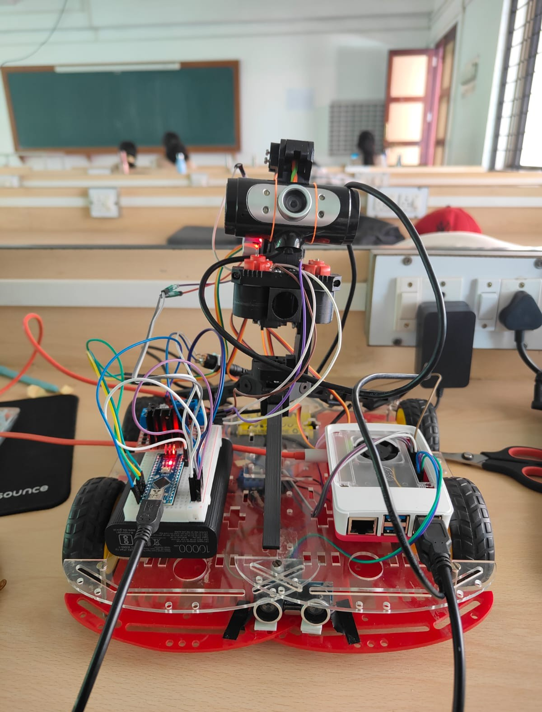
Methodology
Hardware: Sentinel Turret Rover

Slide 9
Methodology
Software Pipeline
Step1: Data Preprocessing
Face cropping using DLib Face detector Splitting into training and testing data
Augmenting training data to reach a specified no.of samples
Step2: Model Training Step3: Real Time Testing

Slide 10
Methodology
Data Augmentation Pipeline
Resize
Random Horizontal Flip Random Rotation
Random Aﬀine Transformation (rotation, translation, scaling) Color Jitter (brightness and contrast)
Gaussian Blur Noise Injection

Slide 11
Methodology
Model Architectures Used
CNN with CBAM (Convolutional Block Attention Module)
CNN with CA-CBAM (Cross Attention Convolutional Block Attention Module) CNN with ArcFace CA-CBAM
YOLO based Self Attention

Slide 12
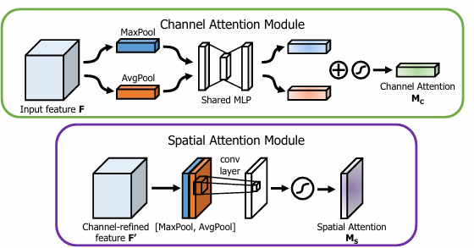
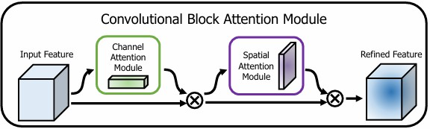
Methodology
CBAM (Convolutional Block Attention Module)

Slide 13
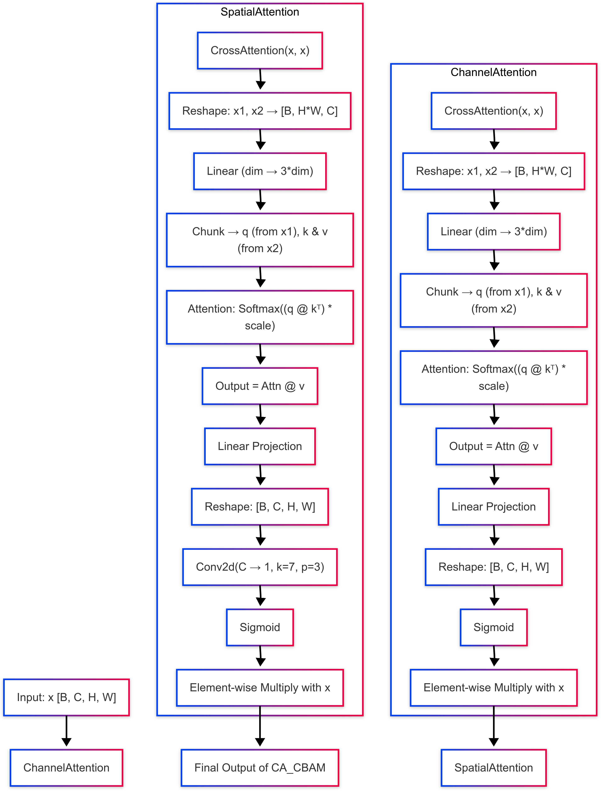
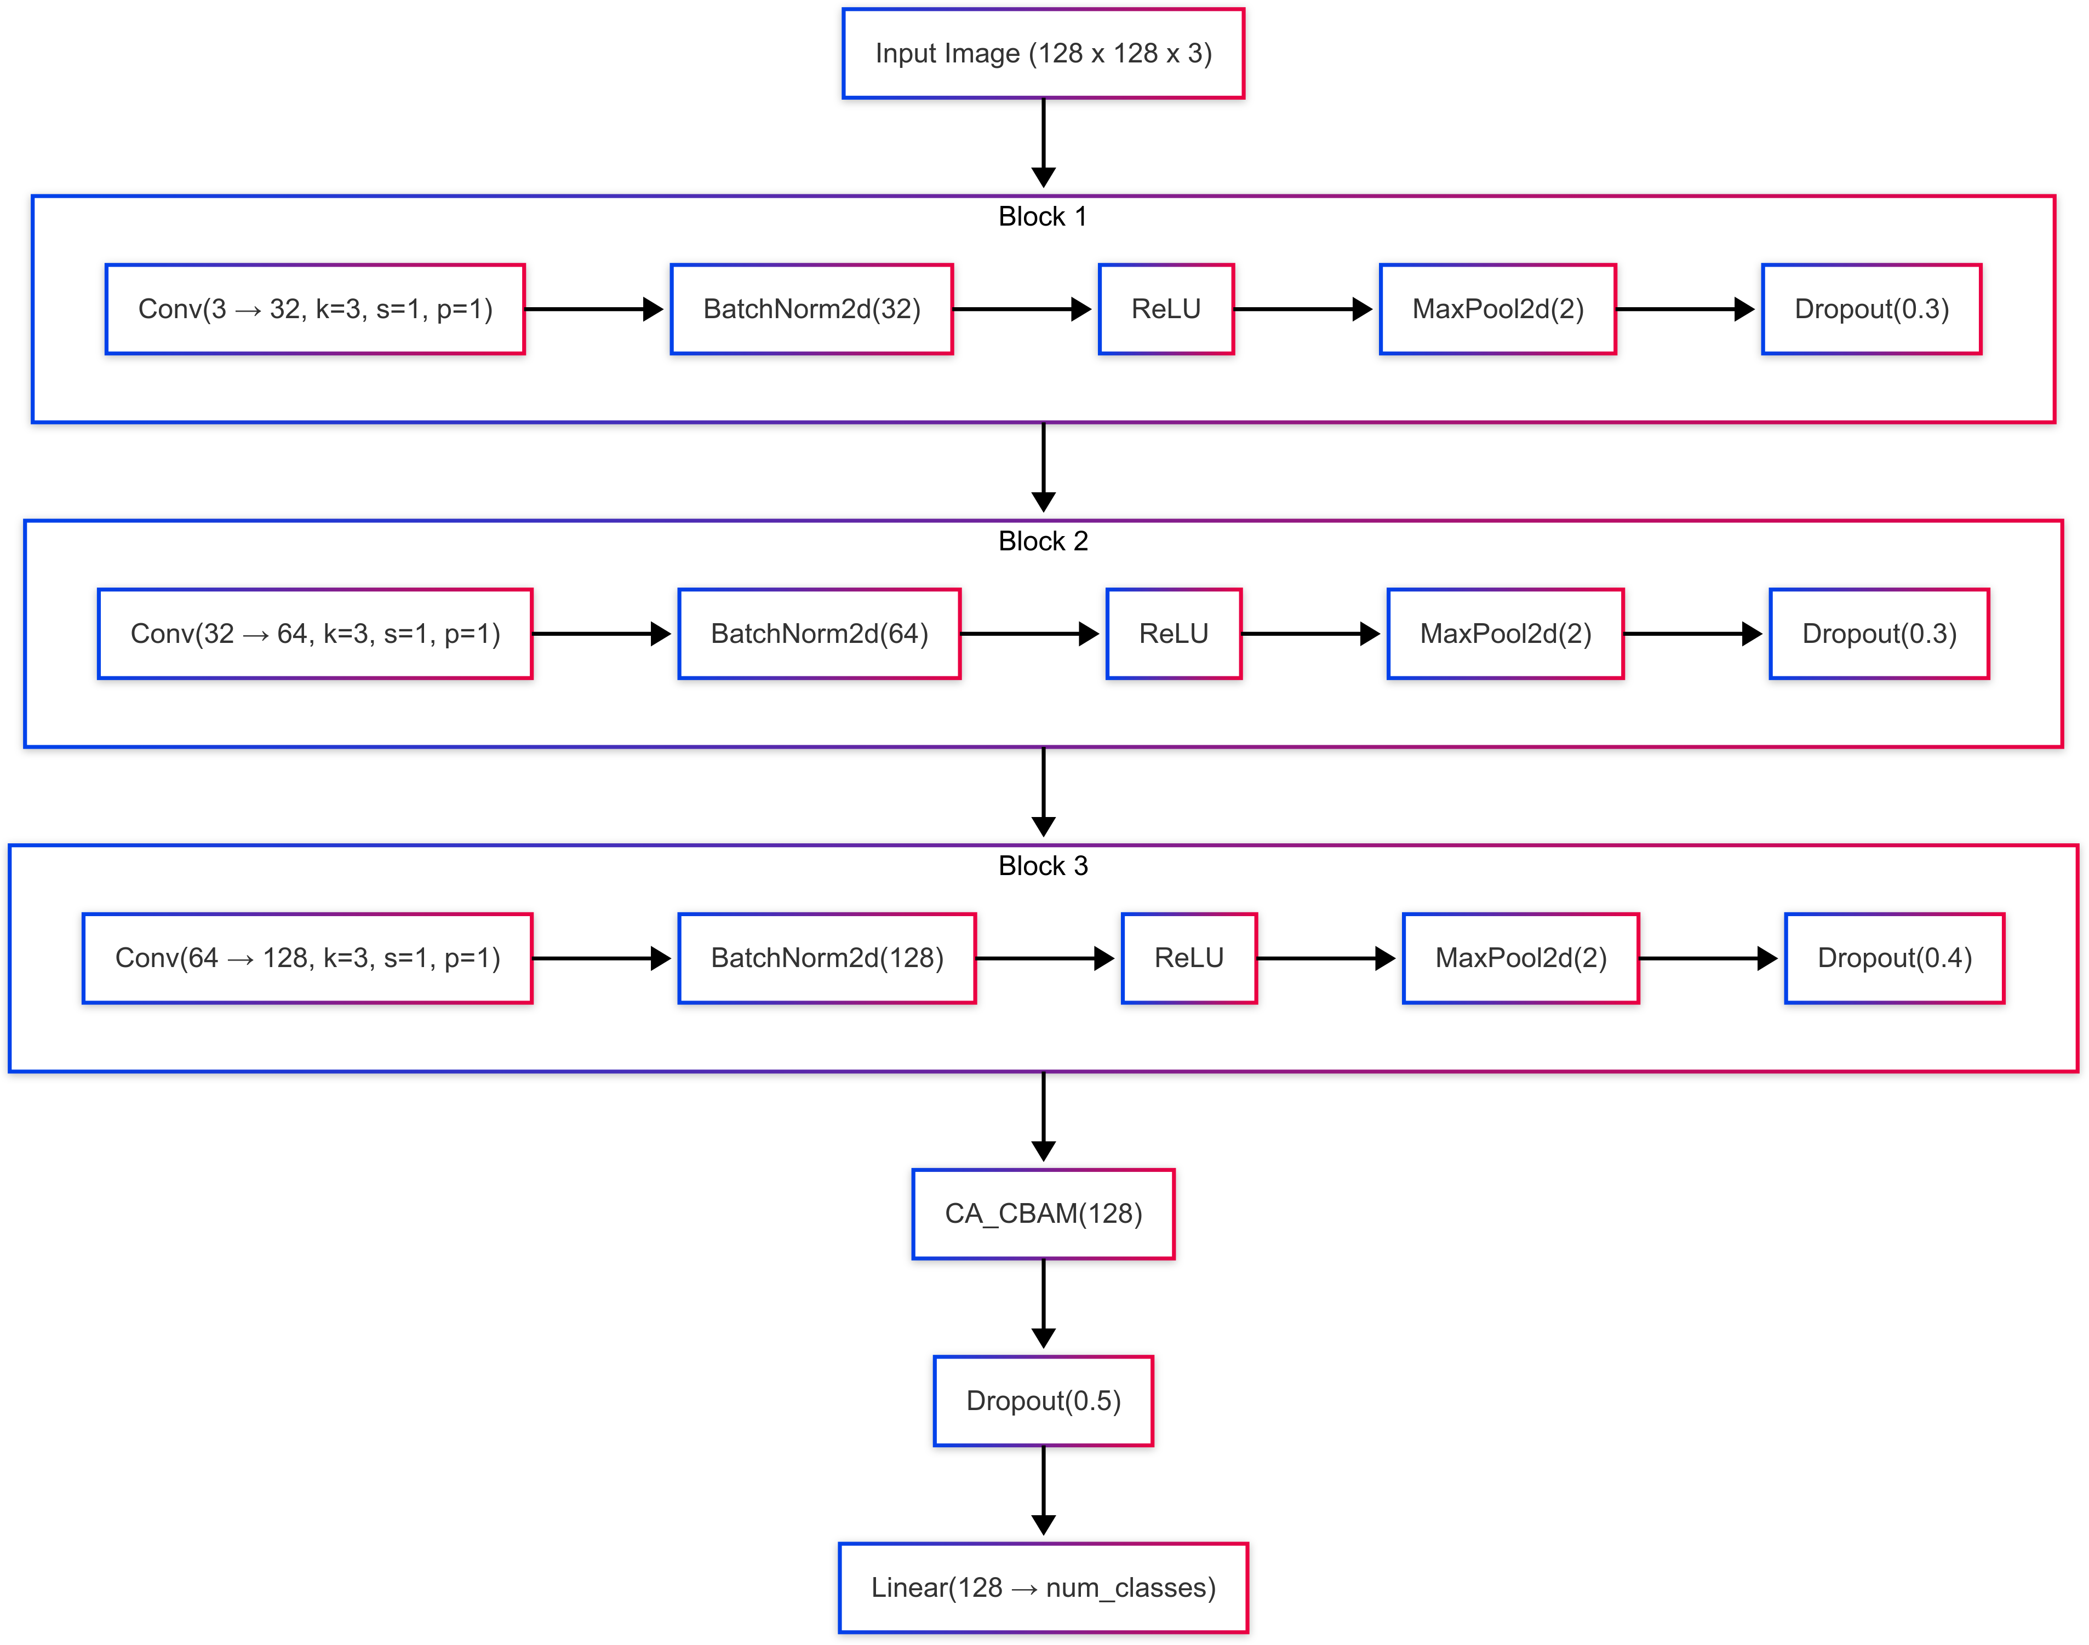
CA CBAM (Cross Attention Convolutional Block Attention Module)
Methodology

Slide 14
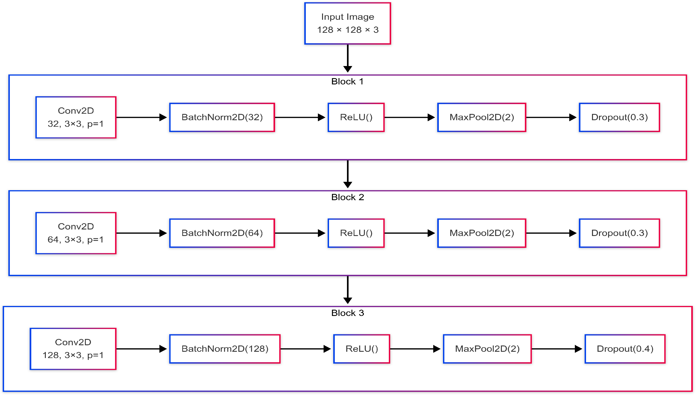
Methodology
ArcFace CA CBAM

Slide 15
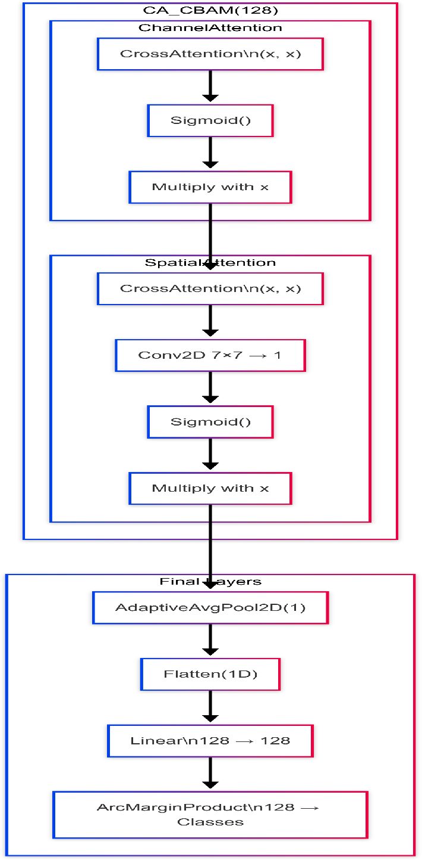
Methodology
ArcFace CA CBAM

Slide 16
Alert System
A Telegram bot is created and integrated with Python code, which performs real-time classification
and triggers the bot to send live notifications to the user via Telegram.
Python requires the BOT_TOKEN and CHAT_ID as follows:
BOT_TOKEN = '8111117866:AAGZI-zZLwbaGVqAIfzKlXclJobiMPtcZe0'
CHAT_ID = '6855415361'
These values are used to send alerts when an intruder or ally is detected.
18 / 26

Slide 17
Methodology
Alert System
If an intruder is detected:
Intruder detected!
Otherwise:
Ally detected!
18 / 26

Slide 18
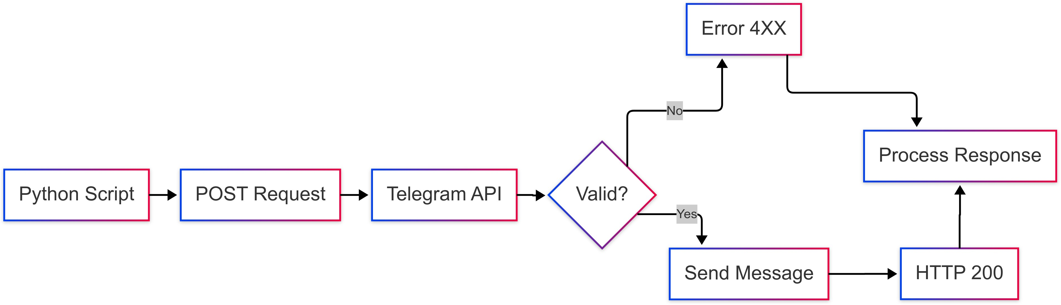
Methodology
Alert System Working Mechanism

Slide 19
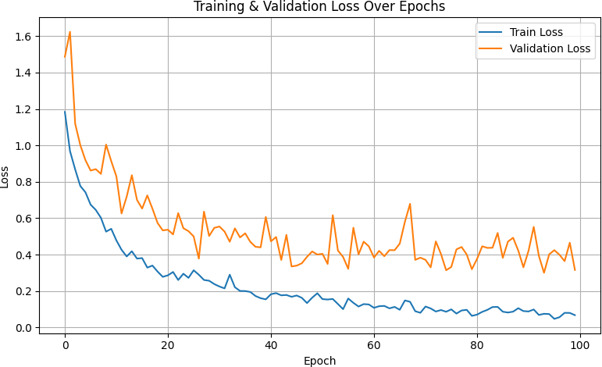
Results & Discussion
Training & Validation loss: CNN with CBAM

Slide 20
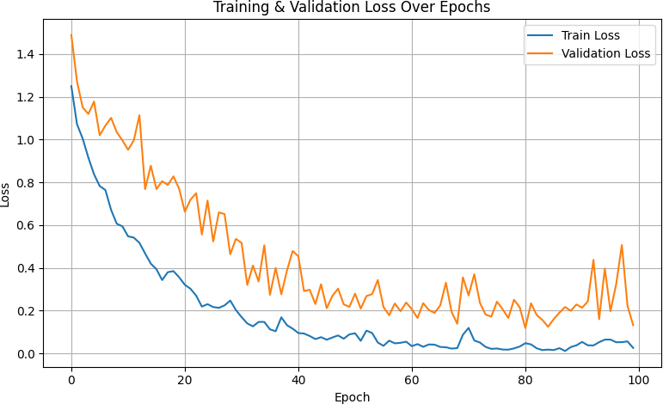
Results & Discussion
Training & Validation loss: CNN with CA CBAM

Slide 21
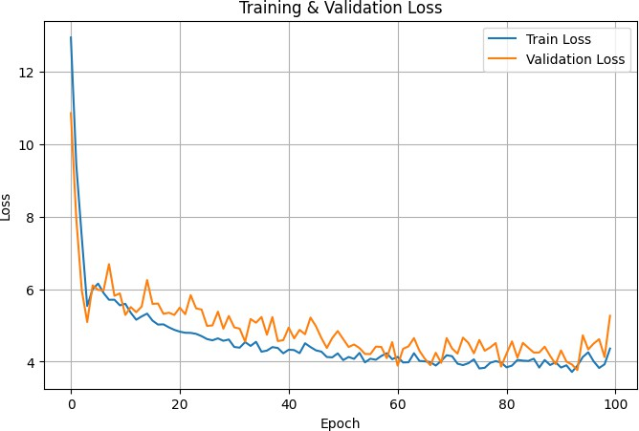
Results & Discussion
Training & Validation loss: CNN with ArcFace CA CBAM

Slide 22
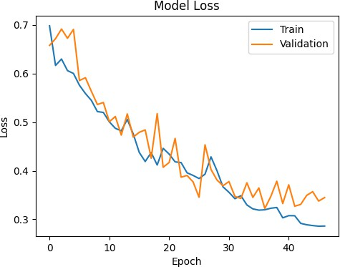
Training & Validation loss: YOLO based Self ATTENTION
Results & Discussion

Slide 23
Results & Discussion
Model Performance Comparison
Table: Classification Accuracies of Different Models
Training Acc. (%) Testing Acc. (%)
Model
CBAM | 99.00 | 97.50
CA-CBAM | 95.38 | 92.50
ArcFace CA-CBAM | 97.75 | 95.00
YOLO-Self Attention | 94.30 | 93.80

Slide 24
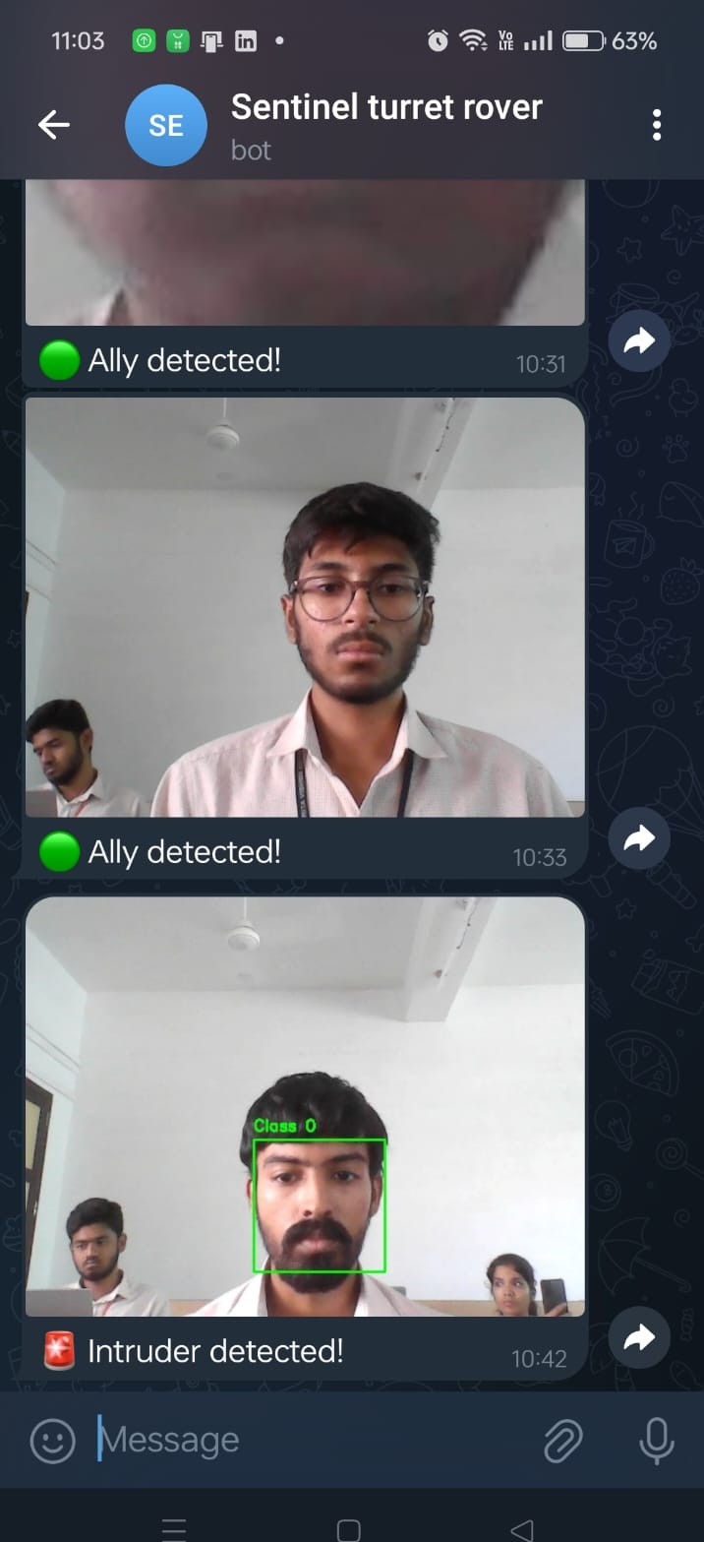
Results & Discussion
Notification Log from the Telegram Bot

Slide 25
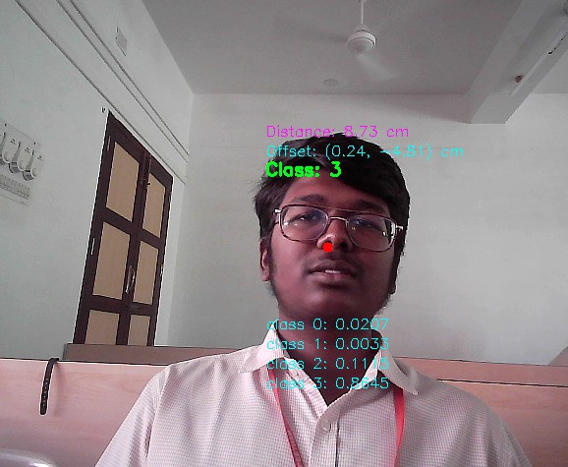
Results & Discussion
Coordinates Calculation for shooting

Slide 26
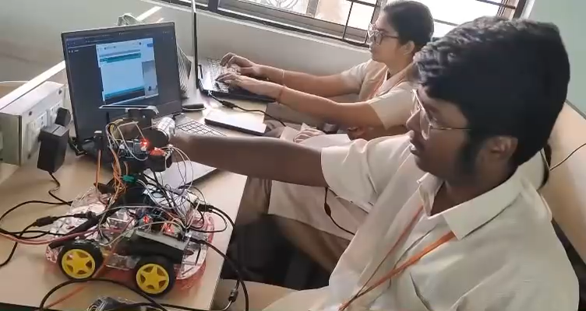
Results & Discussion

Slide 27
Results & Discussion
The system captures a person’s face through the webcam and classifies it into one of the predefined classes, displaying the predicted class along with the probability and bounding box coordinates on the image and distance between the turret and person along with their coordinates.
If an intruder (unknown person) is detected, the turret automatically aligns itself to the detected coordinates and initiates the firing sequence.
Simultaneously, an alert message is sent to the designated recipient using the specified BOT_TOKEN and CHAT_ID.

Slide 28
Future improvements
Lack of quality of camera
Portability issues
Improve shooting range
Model training efficiency can be improved

